Slide 1

Heart Disease
Prediction
Modeling patient attributes to project a diagnosis
DATA 201A FALL 2020
TEAM 7 Group: Sophia Zhang, Xinyi Xu, Yuanyuan Teng
Reference Dataset: https://www.kaggle.com/ronitf/heart-disease-uci

Slide 2


01
02
03
04
Motivation & Hypothesis
Data & Variables
Analysis Results
Summary & Conclusions

Slide 3

01
Motivation & Hypothesis

Slide 4

Motivations
Mortality Rate
According to statistics in 2019 from the World Heart Federation, one out of 3 death around was caused by a cardiovascular disease.
The report also show that 80% of people who die of cardiovascular disease come from developing countries and regions.
80%
In addition, the mortality rate of cardiovascular diseases in these countries and regions continues to rise with the increase in the number of obese patients and smokers.
The mortality rate of cardiovascular diseases is still much higher than other diseases including cancer and AIDS.
33%
Developing Region

Slide 5

02
Data & Variables

Slide 6

Variables Description
Age
Blood Sugar
Blood Disorder
Max Heart Rate
Exercise Chest Pain
Sex
The person's fasting blood sugar
A blood disorder called thalassemia
The person's maximum heart rate achieved
Exercise induced angina
Number of Blood Vessels
Blood Pressure
Cholesterol
ST Depression
ECG Reading
The person's resting blood pressure
ST Depression relates to positions on the ECG plot
The number of major vessels (0-3)
that are not blocked
Resting electrocardiographic measurement
Chest Pain Type
Slope (ECG)
The chest pain experienced on a scale of 1 to 4
The slope of the peak exercise ST segment

Slide 7
Pre-Analysis Hypothesis
Chest Pain Type
Blocked Blood Vessel Number
Heart Rate
Age
Cholesterol
Sex
Blood
Pressure
Blood Sugar
Blood Disorder
ECG Results
ECG Results Include:
ST Depression
ST Slope
Resting ECG
We expect that age, blood pressure, cholesterol, sugar level are most important variables

Slide 8
03
Analysis Results

Slide 9
Distribution of Age
No Heart Disease
Heart Disease
Mean ~ 55
NORMAL DISTRIBUTION
Notes:
First we expected as people get older there will be more cases of heart disease.
In other words, the distribution should skew towards seniors.
However, we discovered the opposite.
Surprisingly, the age distribution of those with heart disease looks normal.
The mean and median is around 55 years old.
There is no positive relationship between increasing age and increasing heart disease from the graph.
Therefore age does not accurately predict heart disease as we previously thought.

Slide 10
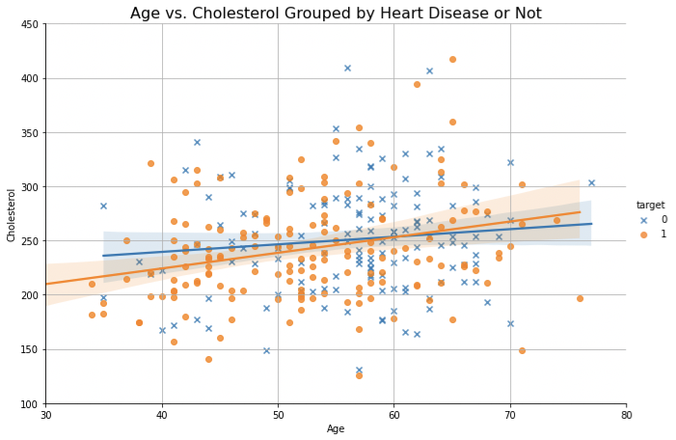
Cholesterol Effect
Heart Disease
NO Heart Disease
Intersect at 60 yrs old
Notes:
Next we looked at another variable we think is important, cholesterol.
We expect that cholesterol level would be higher for those with heart disease than those without.
However, the graph shows that it only happens for patients older than 60 years old, but it’s not significant.
Most of the graph shows cholesterol level is actually higher in people without heart disease.
The raw data points are quite mixed together so its not a clear relationship.
We cannot say cholesterol can predict heart disease on its own.

Slide 11
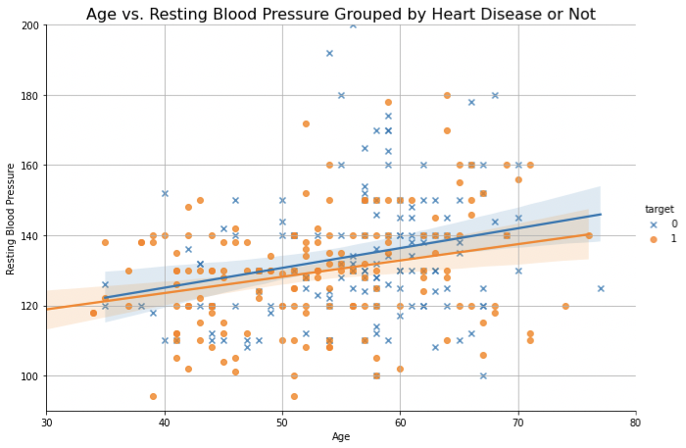
Blood Pressure Effect
NO Heart Disease
Heart Disease
Notes:
Finally we looked at blood pressure, a variable we thought would be a great predictor of heart disease.
We expect that blood pressure would be higher for those with heart disease.
We were surprised to find that the opposite is true.
The data shows blood pressure on average is actually higher in people without heart disease.
Even more unexpected, this difference actually increases as the patient gets older.
If this is true, then blood pressure might be an inverse predictor of heart disease.
However the difference is not significantly big enough to make this conclusion.

Slide 12
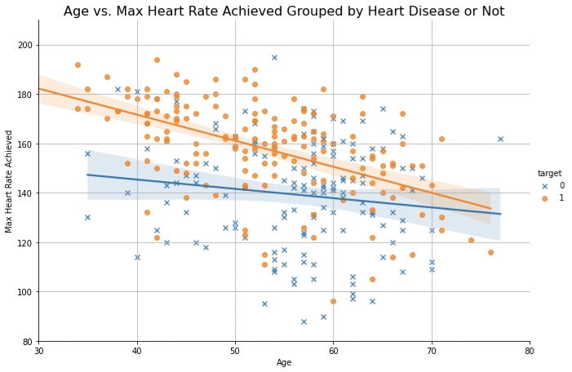
Max Heart Rate Effect
Heart Disease
Separation at 150 bpm
NO Heart Disease
Notes:
Moving on to a few variables we didn’t expect to have a significant effect on heart disease.
First we found that the maximum heart rate was higher for those with heart disease.
Especially in younger patients, the difference in heart rate was much higher.
There is a clear separation between the data points for no heart disease vs heart disease.
Approximately 80% of those with heart disease exceed a heart rate of 150 bpm, while only 30% in the no heart disease exceed it.
This indicates there is a distinctive relationship, and max heart rate can be a better predictor of heart disease.

Slide 13
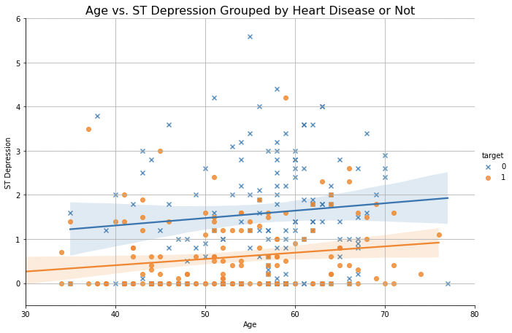
ST Depression (ECG)
NO Heart Disease
Consistent Difference
Heart Disease
Notes:
Another variable that shows an even more distinct relationship is ST Depression, a component related to the ECG reading.
It is clear from this graph that those in the heart disease group have a much lower ST Depression than those in the no heart disease group.
For most heart disease patients, ST Depression never exceeds 1.
Whereas for no heart disease patients, it usually falls between 1 to 2.
There is a clear divide between the two groups, this indicates a very low ST Depression can be a good indicator of heart disease.

Slide 14
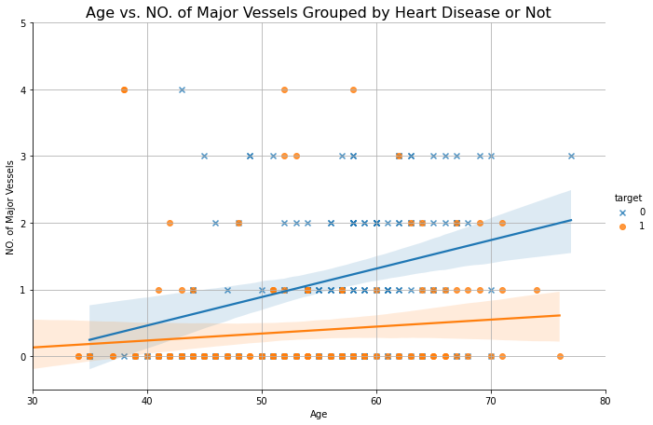
Blockage of Blood Vessels
NO Heart Disease
No Heart Disease
Heart Disease
Heart Disease
Notes:
Number of blood vessels that are not blocked has a similar relationship to heart disease as ST Depression.
The lower the number, the more likely the patient has heart disease.
It is a fairly good predictor based on this data.

Slide 15
04
Summary & Conclusions

Slide 16
SUMMARY
What was the DATA?
Hospital admission data for 302 patients, 14 variables
What was our GOAL?
Determine top attributes that predict heart disease
What did we LOOK at?
Personal:
Age, Sex, genetics (blood disorder)
Technical:
ECG components, blood vessels, chest pain type
Measurements/Condition:
Blood pressure, blood sugar, cholesterol, heart rate
What did we LEARN?

Slide 17
PRE-Analysis Perspective
Chest Pain Type
Blocked Blood Vessel Number
Heart Rate
Age
Cholesterol
Sex
Blood
Pressure
Blood Sugar
Blood Disorder
ECG Results
ECG Results Include:
ST Depression
ST Slope
Resting ECG
We expect that age, blood pressure, cholesterol, sugar level are most important variables
Notes:
In our pre-analysis hypothesis we expected that age, blood pressure, cholesterol, sugar level are most important variables.

Slide 18
POST Analysis Perspective
Chest Pain Type
Blocked Blood Vessel Number
Heart Rate
Age
Cholesterol
Sex
Blood
Pressure
Blood Sugar
Blood Disorder
ECG Results
ECG Results Include:
ST Depression
ST Slope
Resting ECG
Analysis shows most important variables are ECG results, heart rate, and blood vessels
Notes:
After the analysis, results shows most important variables are ECG results, heart rate, and blood vessels

Slide 19




Potential Issues with Data
Effect of medication not accounted. ‘True’ conditions could be masked.
Sample size can be bigger –55% had heart disease; not representative of general population
Short term prediction vs long term prediction
(What happens when patient leaves hospital?)
Other interaction effects
(Original hospital data had 76 variables)

Slide 20




CONCLUSIONS
THIRD
Data suited for predicting hospital diagnosis for individual patients in the dataset. To extrapolate to the population for prevention, more variables need to be investigated.
FIRST
Traditional beliefs about heart disease indicators many be biased
SECOND
Readings from ECG results and max heart rate are a better indicator based on the data
Notes:
•Initially hypothesis: age, blood pressure, sugar level, and cholesterol largest effect on heart disease prediction.
•Based on our analysis, the variables max heart rate and ECG results (ST depression), and number of unblocked blood vessels are better predictors of heart disease.
•Surprising result: don’t go into data analysis with preconceived ideas!
•Should not throw out traditional variables as predictors of heart disease.
•Other considerations: effect of medication, small sample set, interpolation vs extrapolation
•This data may be better for predicting within a specific set

Slide 21
Questions?

Slide 22
THANK
YOU!

